Slide 1
countyelections.org • (555) 555-5555 • TTY 555
General Election 2018
County Board of Elections
Pocket Guide
for Voters

Slide 2
Vote if you have been registered at your current address at least 22 days before Election Day
Ask any election officer for help
Be shown how to mark and cast your ballot
Ask for a new ballot if you want to change your vote before you cast it
Cast a provisional ballot if you have no photo ID with you or if your name doesn’t appear on the voter list and you believe it should
Bring your small child into the voting booth
Vote if you are in line by 7:00 p.m. when the polls close
You have the right to
You cannot be denied the right to vote if you are legally qualified to do so.

Slide 3
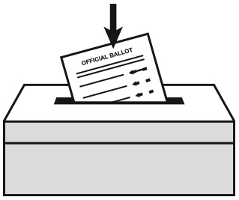
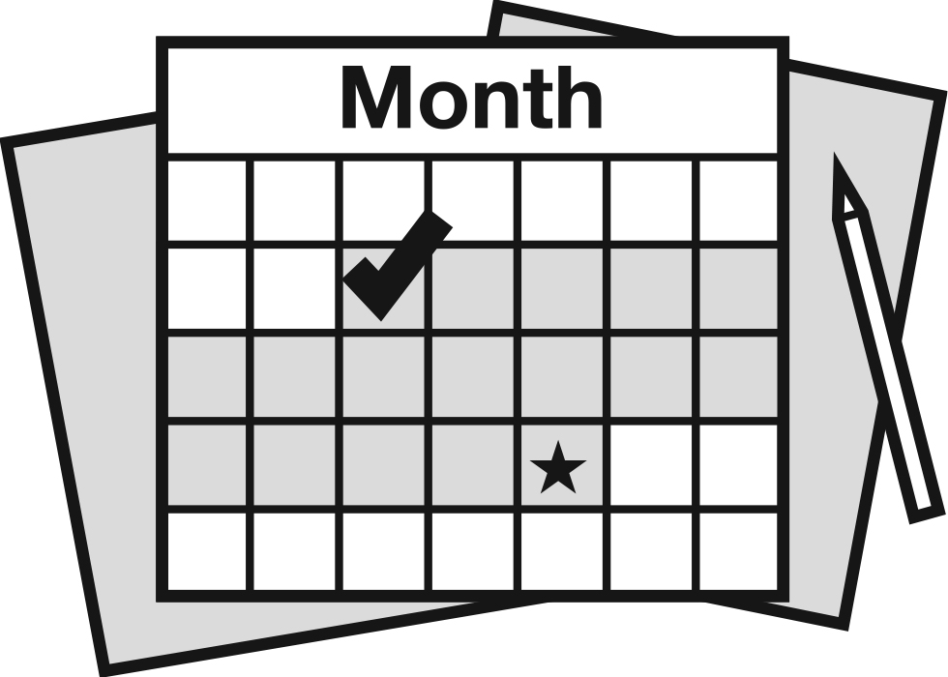
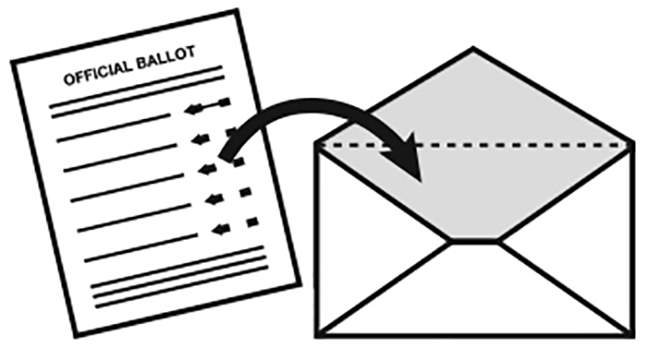
At the polls on Election Day
Polls are open on Election Day, November 6, 6:00 a.m. – 7:00 p.m.
Look up your polling place
• Online at countyelections.org
• By calling the State Department of
Elections at 555-555-5555
In person before Election Day
You may qualify to vote early at the voter registration office. Learn more at countyelections.org. Early voting period: September 21 – November 3.
By mail as an absentee voter
Request an absentee ballot by 5:00 p.m. on October 30 at countyelections.org. Return it by mail, deliver it to the voter registration office, or drop it at your polling place on Election Day.

Slide 4
October 15
Register to vote, or update your address.
If you move, your polling place will change. Be sure to update your voter registration address every time you move.
October 30 by 5:00 p.m.
Request that an absentee ballot be mailed to you.
November 3 by 5:00 p.m.
Vote an absentee ballot in person at your local voter registration office.
November 6
Election Day – polls open 6:00 a.m. to 7:00 p.m.
Find out more at countyelections.org or (555) 555-5555 or TTY 555.

Slide 5
You need to show your photo ID whenever you vote in person.
If you get to the polling place without photo ID, you will have to vote on a provisional ballot.
Acceptable forms of identification
State driver’s license
State DMV-issued photo ID
United States passport
Employer-issued photo ID
State Voter Photo ID card
Other U.S. or State government-issued photo ID
Student photo ID issued by a school, college, or university located in State
Tribal enrollment or other tribal photo ID
If you don’t have one of these, you can get a free Voter Photo ID at any State voter registration office, including on Election Day!

Slide 6
When you arrive, election officers will be there to help you.
Check in
Say or write your name and address.
Show your acceptable photo ID.
Get your ballot
a
Check your ballot
Does it include all contests for your district?
Go the the voting booth and vote your ballot
If you are not on the voter list, or if you didn’t bring a photo ID, an election officer will direct you to vote provisionally.

Slide 7
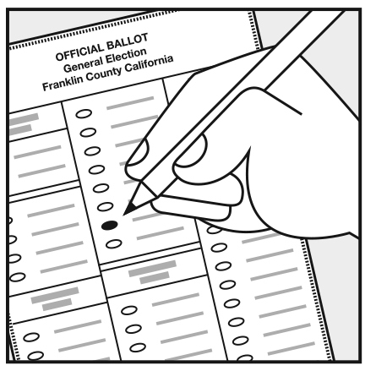
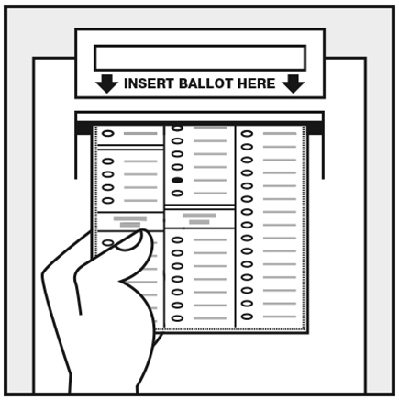
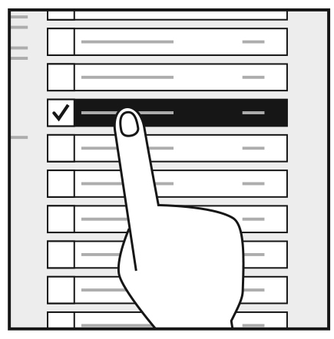
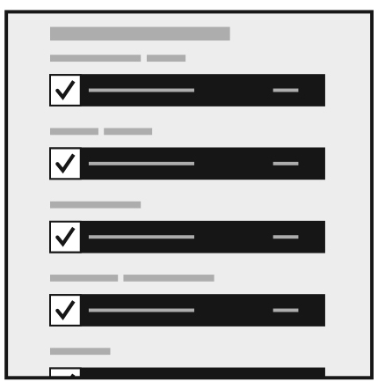
To vote on a paper ballot
Make your selection by filling in the oval next to your choice(s).
When you’re done, scan your ballot.
To vote on a touchscreen
Make your selections on the screen.
Check your votes before you cast your ballot

Slide 8
Before Election Day
Voters with a disability or illness can vote with an absentee ballot by mail or in person before Election Day. Go to countyelections.org to learn more and request your absentee ballot.
On Election Day
There are accessible voting systems at each polling place.
If you are 65 or older, or if you have a physical disability, you can vote from your vehicle at the polling place on Election Day. Remember to bring a helper with you who can go in to request your curbside assistance.
Get help reading or writing from an election officer or your own helper.

